Slide 1
Secrets in Git Repositories

Slide 3
The problem
Every Source control system suffers from storing secrets
Token for cloud services
Password of system/resources
Etc
Git possess some peculiar characteristics that makes this a "little more dangerous"

Slide 4
The problem
With the advent of the cloud we have more services exposed to the public internet
Often (most of the time) it is not necessary
Lack of proper knowledge to secure resources
If some secret leaks it makes your resource immediately accessible

Slide 5
DEMO
Lets see what can happen with a Git repository
That contains a secret leaked

Slide 6
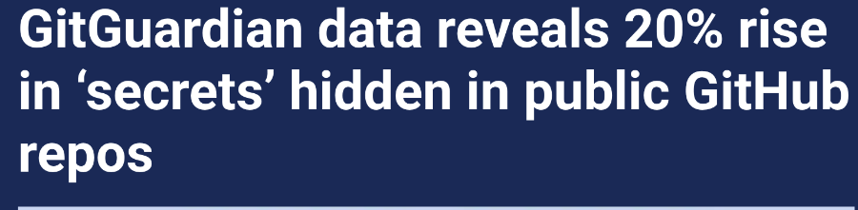
Some numbers
https://venturebeat.com/security/gitguardian-data-reveals-20-rise-in-secrets-hidden-in-public-github-repos/

Slide 7
Some numbers by Bing Chat
According to a report by GitGuardian, a cybersecurity platform, more than 2 million secrets were found in public GitHub repositories in 2020, which is a 20% increase from the previous year ¹.
The same report also states that this year alone, there will be at least a 20% increase in exposed secrets compared to the year before ².
The report also highlights that 85% of the leaks occur on developers’ personal repositories and only the remaining 15% within repositories owned by organizations ².
The report also mentions that on average, 3 commits out of 1,000 exposed at least one secret, which is a 50% increase compared to 2020 ³.

Slide 8
The problem is WELL known
https://blog.gitguardian.com/the-state-of-secrets-sprawl-2023/
10 million new secrets occurrences were exposed on GitHub in 2022. That's a 67% increase compared to 2021.
1 GitHub code author out of 10 exposed a secret in 2022
secrets were found in one way or another in most of the security incidents that happened in 2022
infrastructure as code is one of the focuses of this edition … increased by 28% in 2022
GitGuardian estimates that 21.52% of all Terraform repositories have one or more security policy vulnerabilities

Slide 9
Stage of leak
Locally Modified
Locally committed
Pushed (private)
Pushed (public)

Slide 10
Locally modified
Locally Modified
Local committed
Pushed (private)
Pushed (public)

Slide 11
Source of problem
Your code structure read secrets in a path that is inside the repository
Change how you read configuration
It will become useful even in production (delete the entire directory each deploy)
.NET CORE
Has a settings system that is hierarchical
You can use a base config (without secrets) in the repository then override files outside the repository
You can use different sources (Environment variables, azure vault, AWS vault etc)

Slide 12
Source of problem
You want to distribute some secret to developers
Secrets to run unit testing
Secrets to connect to a shared test database
Etc
Cryptography to the rescue
Store secrets in azure vault, use RBAC to let developer access secrets
Store secrets encrypted in source code, then store encryption key in a location accessible only by developers (local file, environment variables, etc)
Continuous integration
Github and Azure Devops and others allows to secure store secrets for build/pipeline
You can store secrets in environment variable

Slide 13

Use cryptography to your advantage

Slide 14
Locally committed
Locally Modified
Locally committed
Pushed (private)
Pushed (public)

Slide 15
Locally committed problem
Secret is almost leaked, you just need to push
It is stored inside .git folder and will be removed only after X days and a GC operation
You will usually not rewrite history and you will probably push it in some remote

Slide 16
Local hook to prevent the problem
Git has hooks to allow script to run before some events
You can run a script that checks new code before commit
It has lots of problem
Local to each developer, hard to maintain and distribute
You need to use some tool to identify secrets
You need to keep this tool up to date to detect new possible leak
Fragile

Slide 17
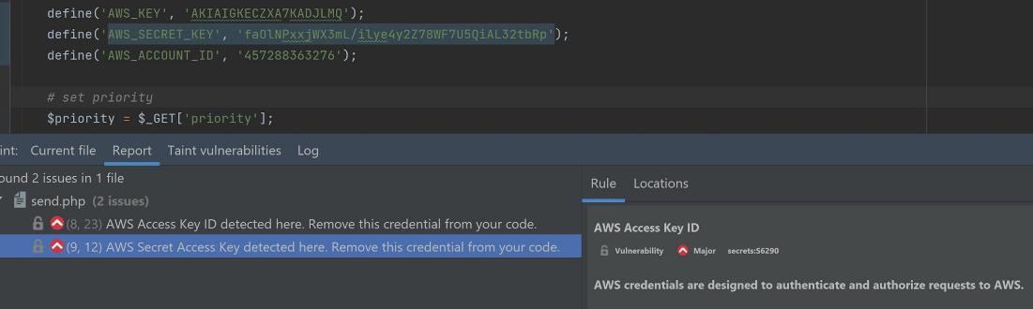
Tools to identify secrets

Slide 18

Probably your secret will be exposed

Slide 19
Secret is pushed
File Modificato
Commit locale
Remote (privato)
Remote (pubblico)

Slide 20
Secret pushed == secret leaked
Everyone that has access to the repository will read the secret
We can audit access to know who fetched the secret after the leak
Fetch will always fetch all remote branches
It is better consider the secret compromised and rotate/disable

Slide 21
Do not assume that you can act fast
… security researcher Craig Hays decided to do an experiment. He wanted to leak an SSH username and password into a GitHub … The first unauthorized login happened within 34 minutes.

Slide 22
Best practices
Plan credential / secret change or rotation in your software
Periodically test procedures to verify that they works
Put in place automated password change procedure if possible
Protect the resource with more than a single secret
Firewall / access rules
Reduce permissions of Personal Access Tokens
Try to avoid secrets, prefer RBAC
Do not absolutely reuse same password for different services

Slide 23
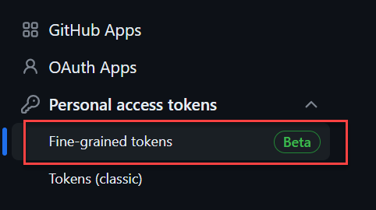
Limit scope whenever possible for bearer tokens
Limit the scope
Check your provider for more fine-grained tokens, like in GitHub.

Slide 24
Pretty please
DO NOT EXPOSE RESOURCES ON THE FREAKING PUBLIC INTERNET

Slide 25
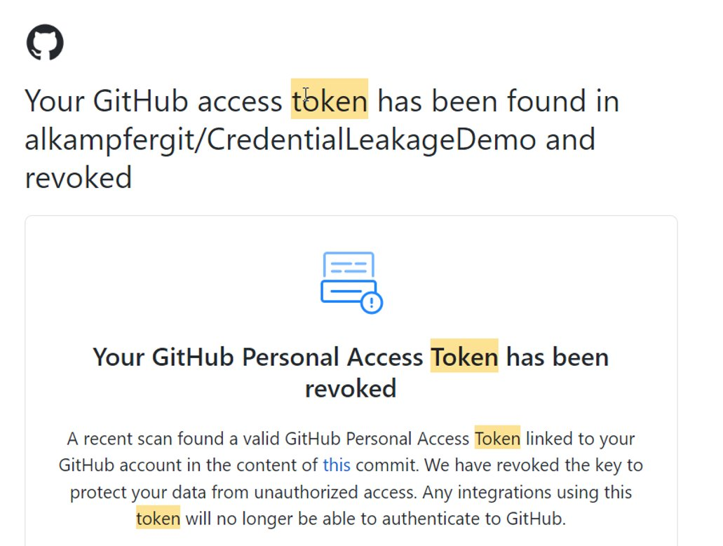
GitHub to the rescue
GitHub automatically scans repository for secrets, it is free for public repositories
Once a GitHub secrets get caugth it is immediately revoked

Slide 26
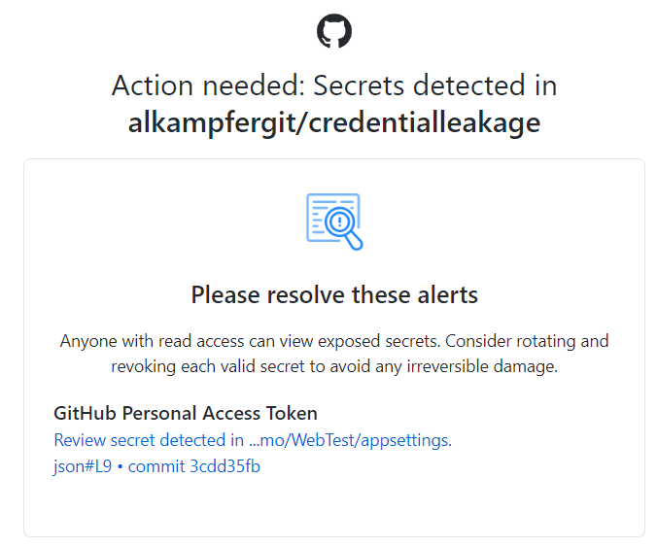
GitHub to the rescue

Slide 27
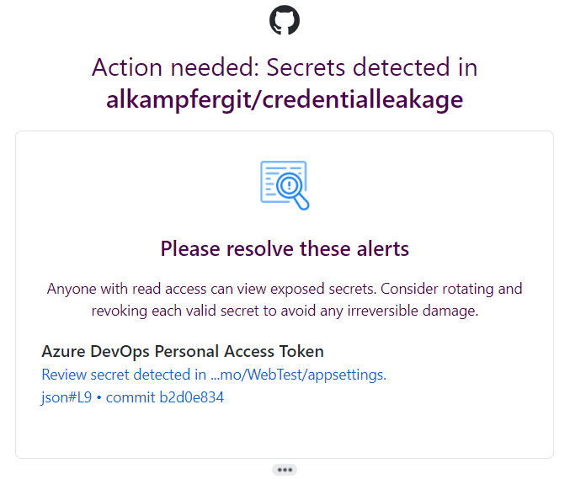
GitHub collaborate with others

Slide 28
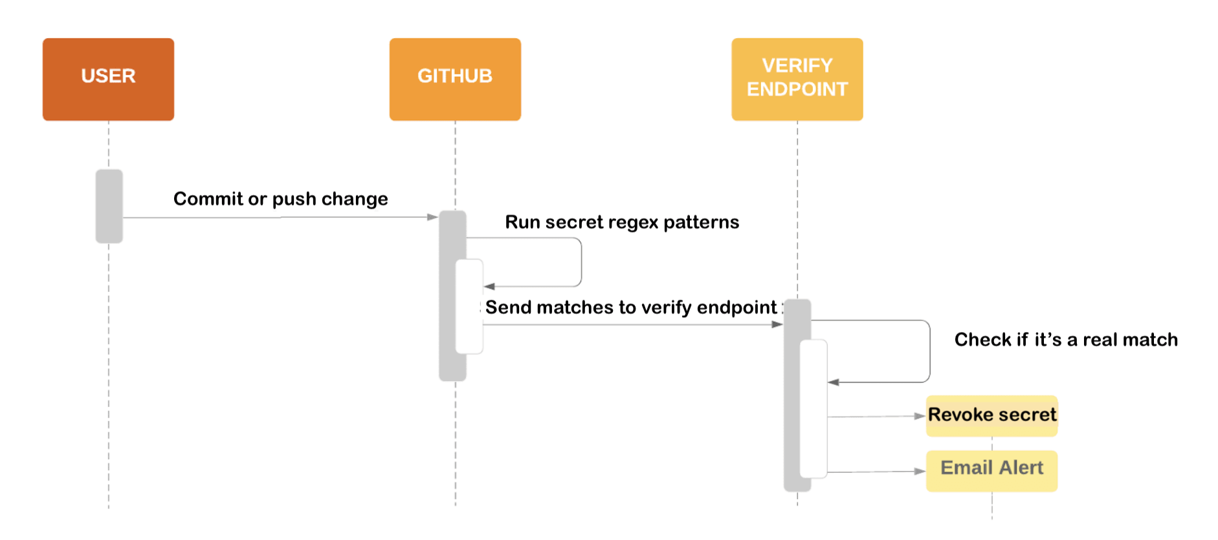
Secret scanning partner program
https://docs.github.com/en/code-security/secret-scanning/secret-scanning-partner-program

Slide 29
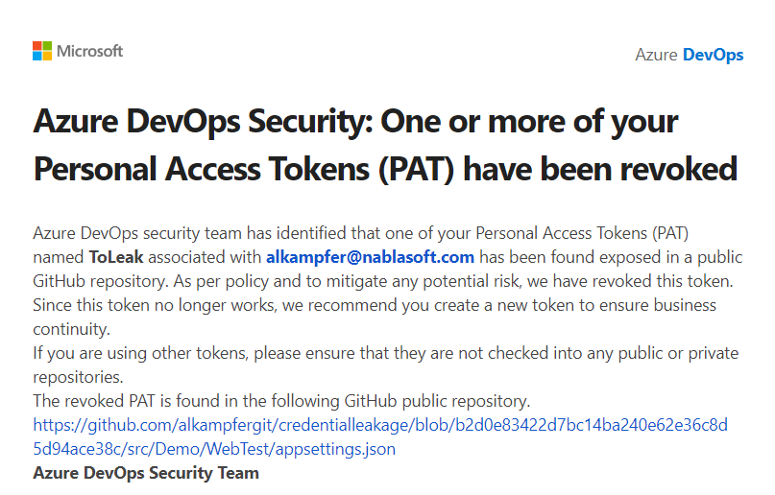
GitHub collaborate with others

Slide 30
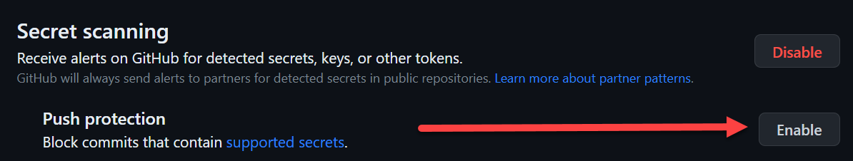
Completely prevent pushes

Slide 31
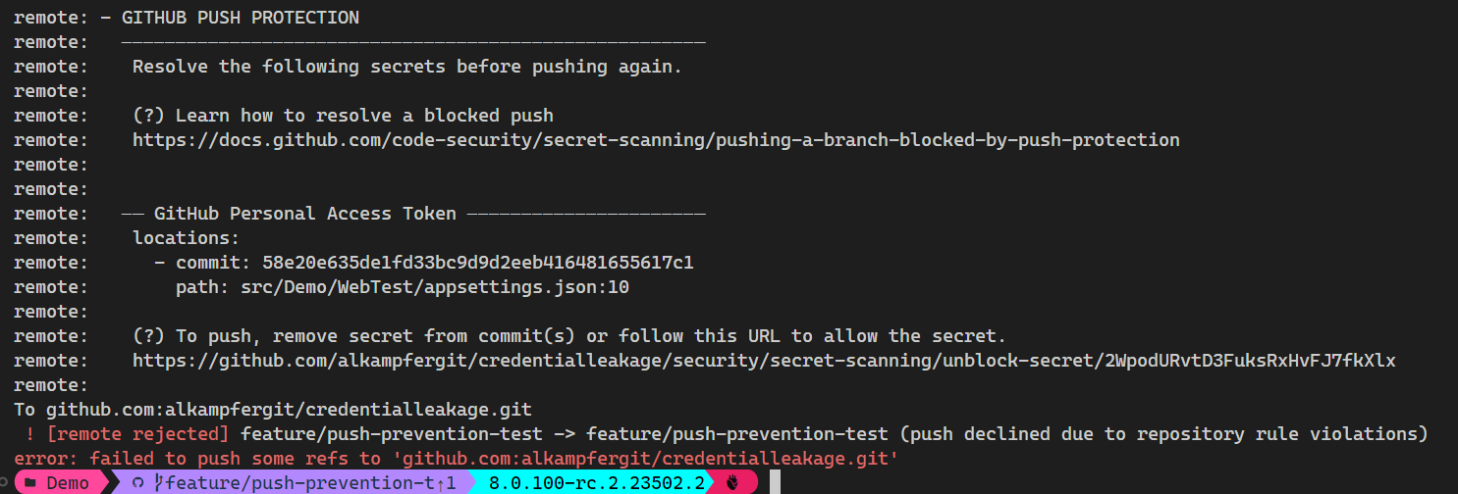
Completely prevent pushes

Slide 32
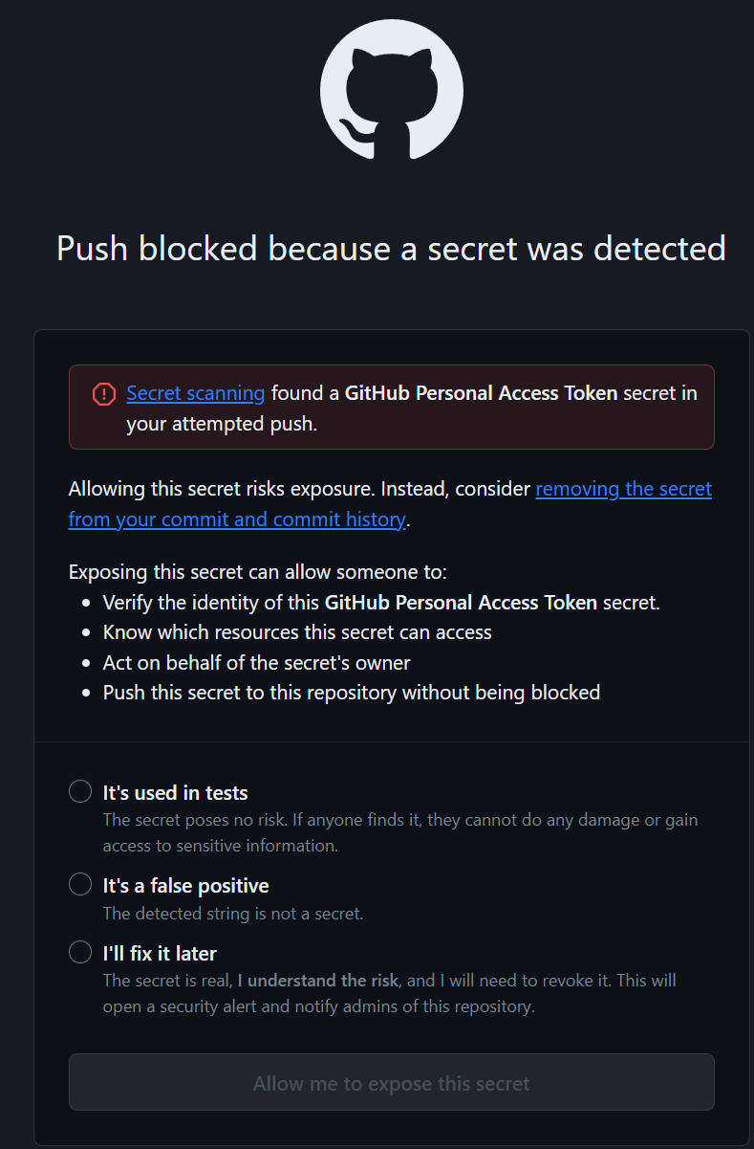
Completely prevent pushes
You can allow specific findings
It allows essentially to leave alone false positives (ex: expired secrets to use in integration test to verify what happens when a secrets is expired)

Slide 33

Remember: security is a mindset

Slide 34

Remember: security is a journey

Slide 35


Who am I
Ricci Gian Maria
alkampfer@nablasoft.com
@alkampfer
https://www.codewrecks.com
https://mvp.microsoft.com/publicprofile/4025635

Slide 36
Name: Ricci Gian Maria
@alkampfer
alkampfer@nablasoft.com
https://www.codewrecks.com

